Slide 1
Prediction of lung cancer patient survival via machine learning
Abhishek Vyas : MT19086
Chirag Chawla : MT19089

Slide 2
Problem Background
Machine Learning algorithms are used to extract the useful patterns from the dataset to predict the outcomes for new unseen data samples.
Machine Learning algorithms are being used in approximately all the areas like finance, insurance, spam detection, fraud detection. It is also being used in biological domain to predict some of the useful information like whether the patient is having heart disease or not etc.
In this Project, our task is to predict the survival time of lung cancer patients.
The goal of evaluating survivability is improving the health care and provide the information to the patients and clinicians, as the survival time is important in order to evaluate the patient prognosis.

Slide 3
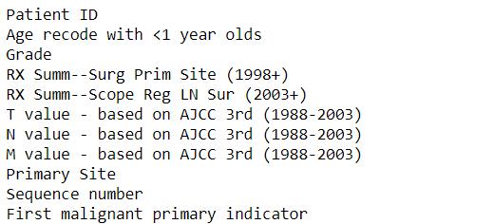
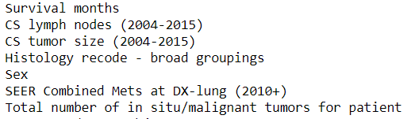
Dataset
We have extracted the dataset from SEER platform of lung cancer patients and who are being diagnosed between 2004 - 2009 (inclusive).
We have extracted total of 18 attributes which are shown below :

Slide 4
Preprocessing
As most of the attributes in our dataset is of type object, so machine learning algorithms can’t fit on these attributes. So we have used label encoder to encode these attributes from object type to int type.
Then we have deleted the duplicate records from dataset.

Slide 5
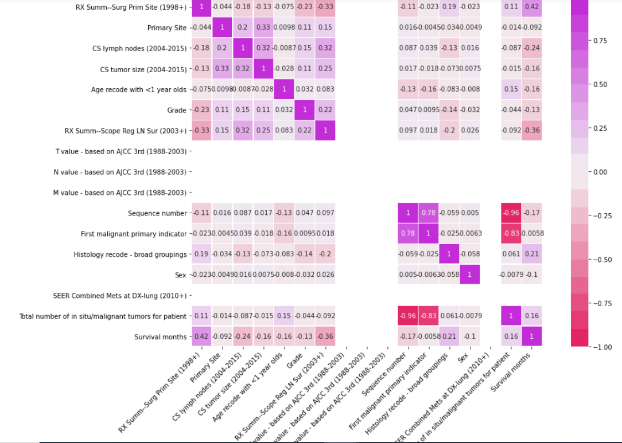
Preprocessing (Heatmap)
Heat map is created which represents the correlation of each attribute with every other attributes.
As we can see, 3 columns ( T-value, N-value, M-value) doesn’t have any correlation with any other attributes.
So these 3 columns are deleted.

Slide 6
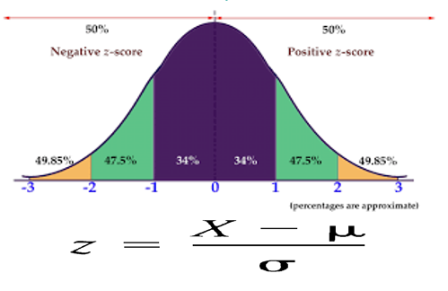
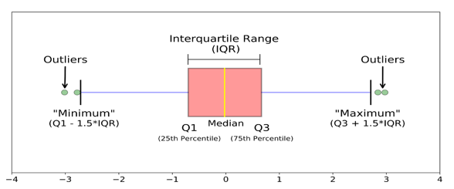
Preprocessing (Removing Outliers by Z-score & IQR)
Z - score : We can find out the number of standard deviation values away from mean. Here in our case we took the data which is in range between -3sd to +3sd.
IQR (Interquartile Range) : We detect the outliers using IQR which tells us the variation in the dataset. Here any value which is beyond the range for Q1-1.5*IQR to Q3+1.5*IQR is treated as outlier where IQR = Q3 - Q1.

Slide 7
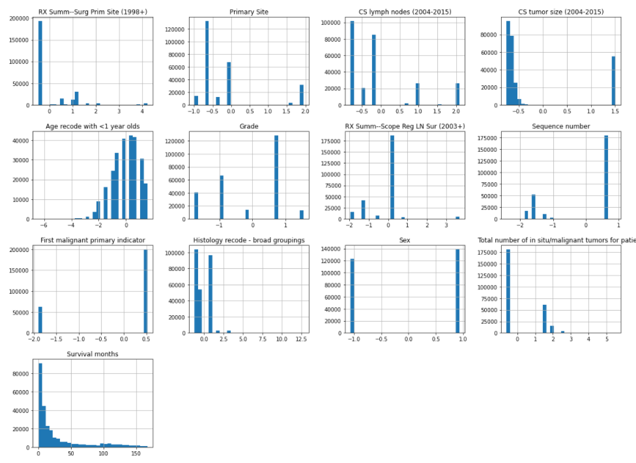
Histogram Plots

Slide 8
Methods :
Decision Tree : Decision tree algorithm basically tries to construct the optimized decision tree from train dataset, using decision tree we can predict the value for test samples. We are using DecisionTreeRegressor from sklearn library with random_state = 0.
Random Forest : Random forest is an ensemble technique, which creates multiple individual decision trees on train dataset. And for test sample, it predicts the outcomes form all the decision trees and then based on the problem it aggregate. In case of classification, it does the voting. While in case of regression, it does the mean of all predicted outcomes.

Slide 9
Methods (Contd.)
SVM : It stands for Support vector machine, it is non-probabilistic model which tries to construct a hyper plane from training dataset which can classify the test samples into class labels. SVM can be used as a regressor. We are using SVR with default parameters from sklearn library.
Linear Regression : Linear regression is a widely used machine learning algorithm for regression problem. It tries to find the linear relation of the attributes with the predicted attribute whose value we have predict by learning the coefficients for each attribute along with the bias. We are using LinearRegression from sklearn library with default parameters.

Slide 10
Methods (Contd.)
Gradient Boosting : Boosting is an ensemble modeling technique which attempts to build a strong classifier from the number of weak classifiers. It is done building a model by using weak models in series.
Ensemble Technique : Ensemble technique is basically is technique which tries to fit multiple individual models on training dataset, and then it predict the outcome for test samples which uses the learning of all these models combined to predict a particular test sample.

Slide 11
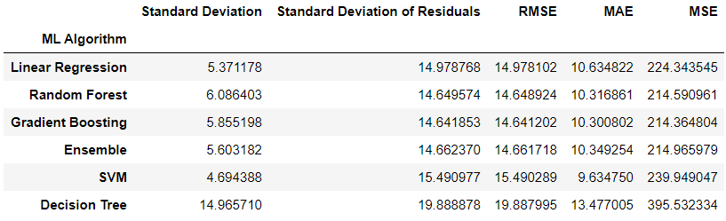
Results :

Slide 12
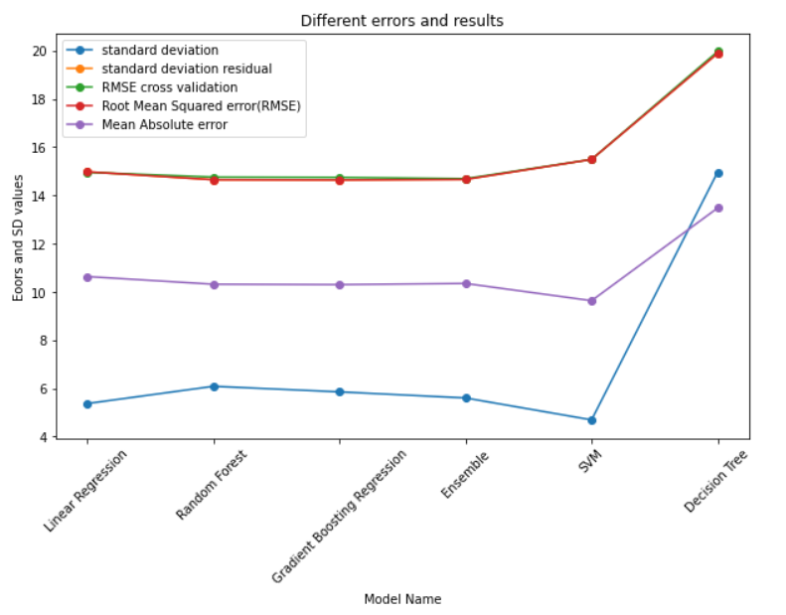
Analysis (Contd.)
RMSE and standard deviation of residuals are approximately same ranging from 14-20.
Mean Absolute Error is ranging from 10-14.
Standard Deviation is ranging from 4-14 for various machine learning algorithms.

Slide 13
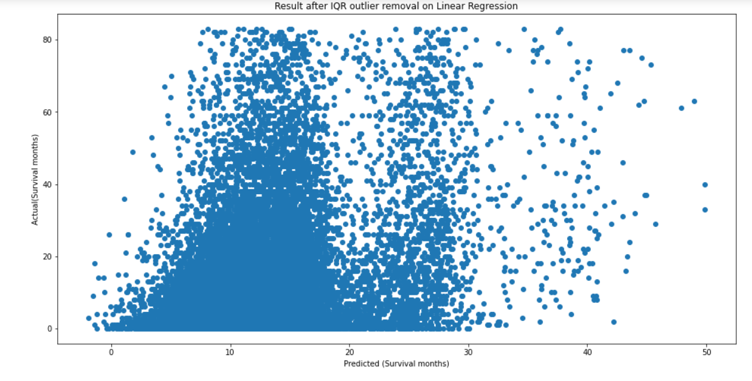
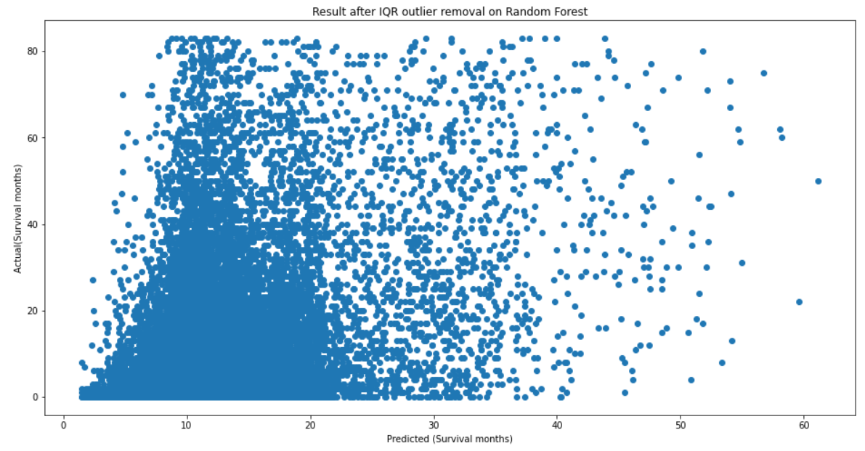
Comparison of predicted to actual survival times :
Random Forest
Linear Regression

Slide 14
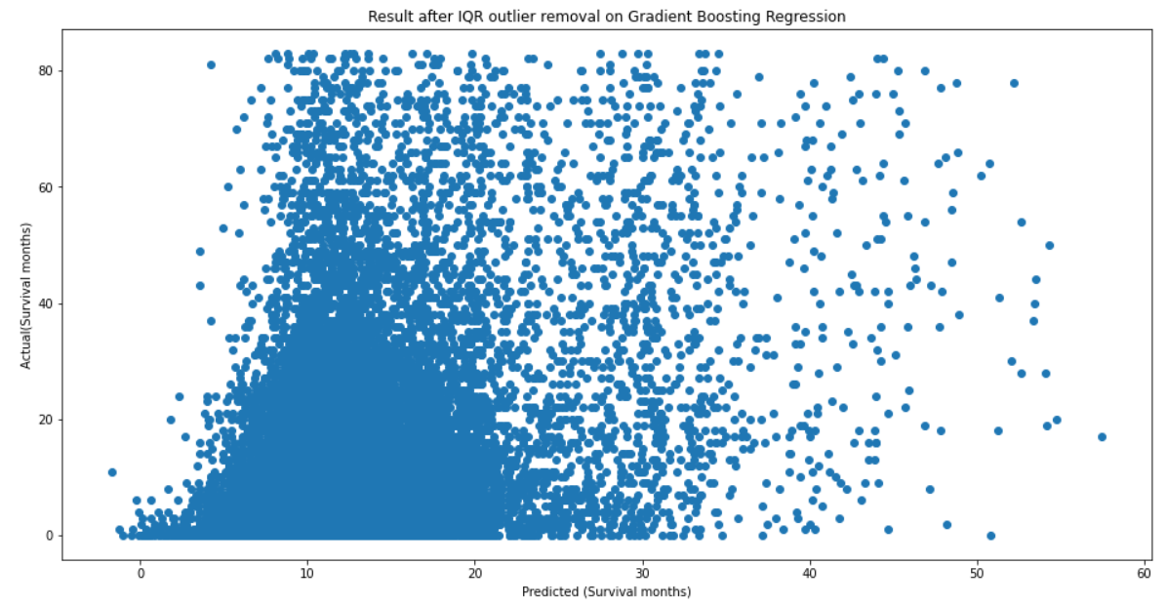
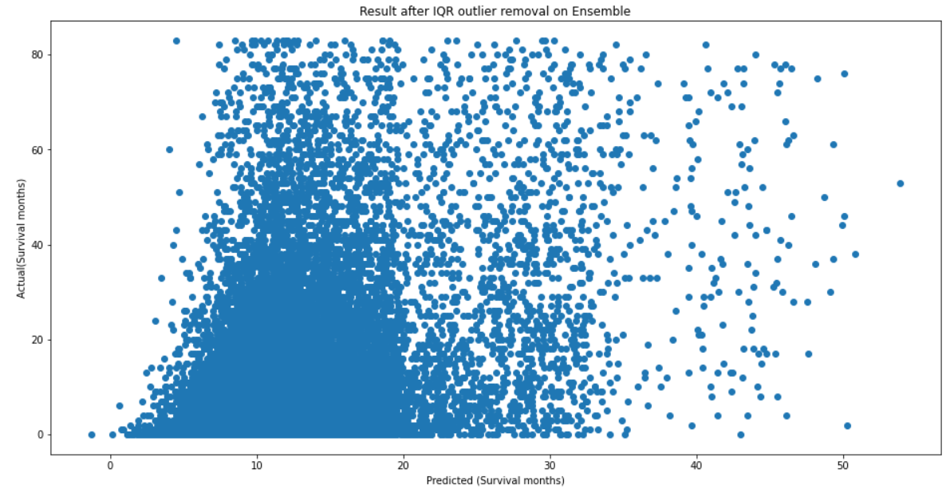
Comparison of predicted to actual survival times :
Ensemble Technique
Gradient Boosting

Slide 15
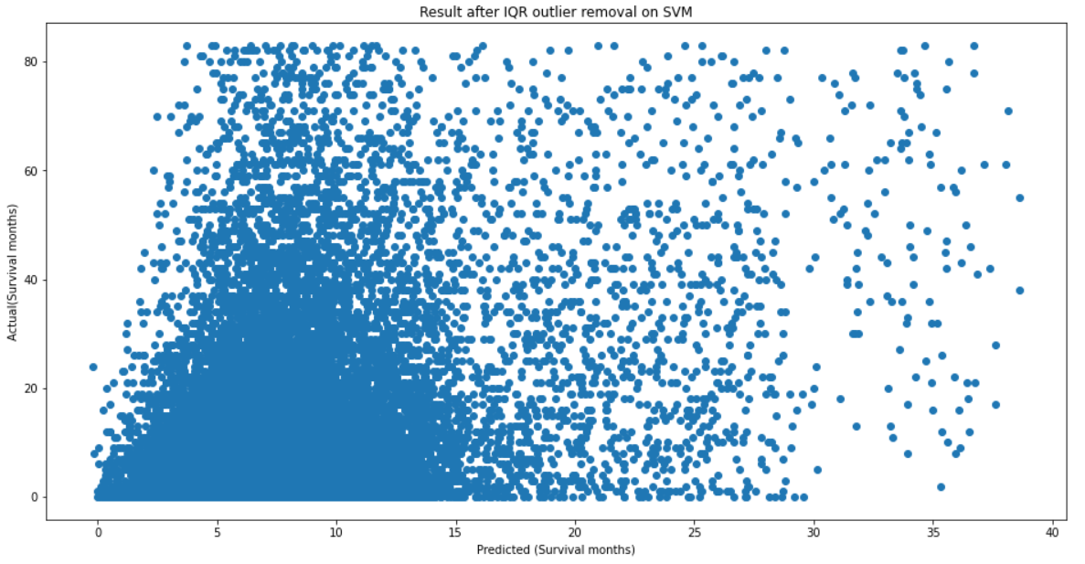
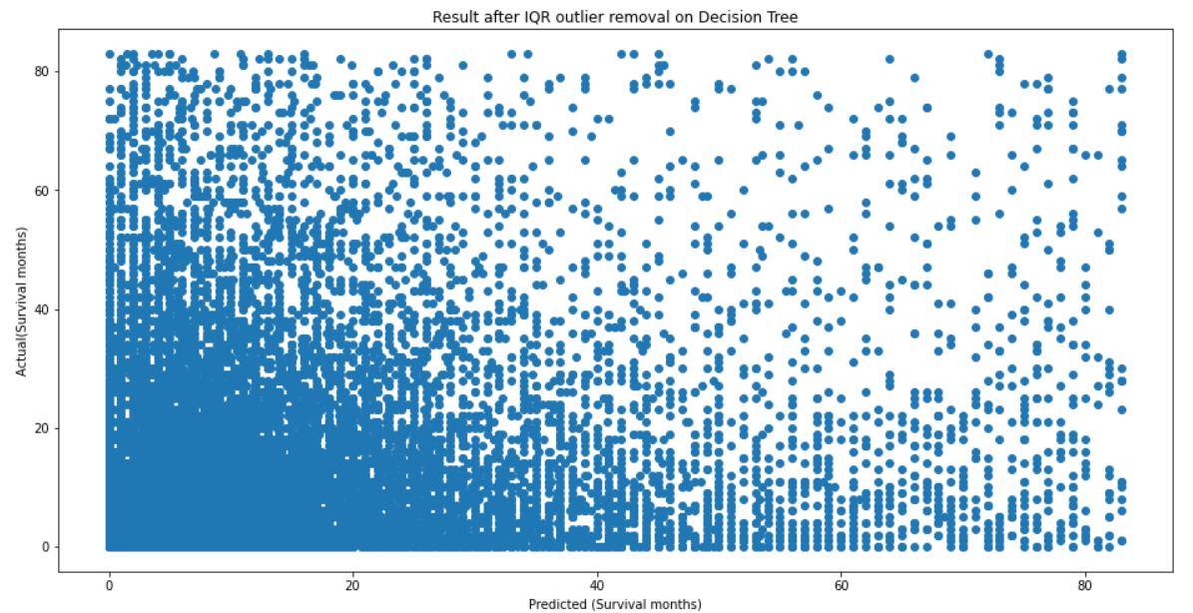
Comparison of predicted to actual survival times :
Decision Tree
Support Vector Regressor (SVR)

